Slide 1
Building a Reinforcement Learning Environment in OpenAI Gym
Paul Swenson

Slide 2

Background for Reinforcement Learning

Slide 3
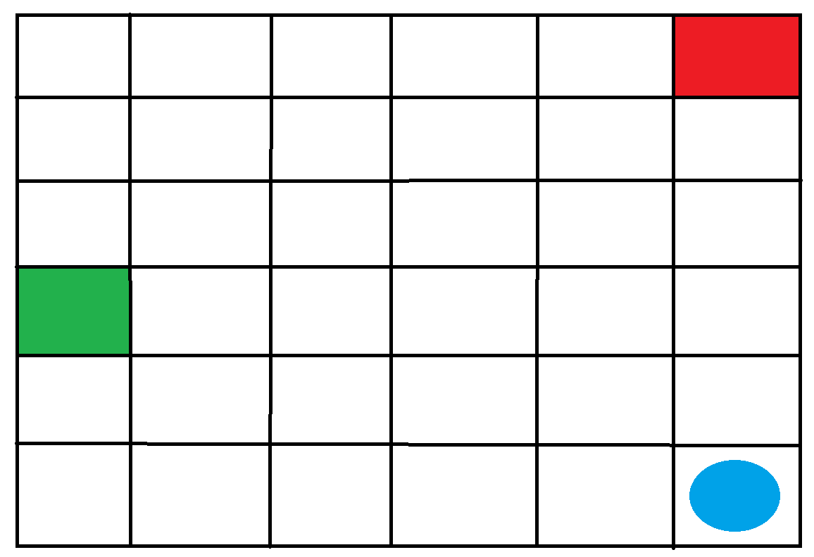
The Game

Slide 4
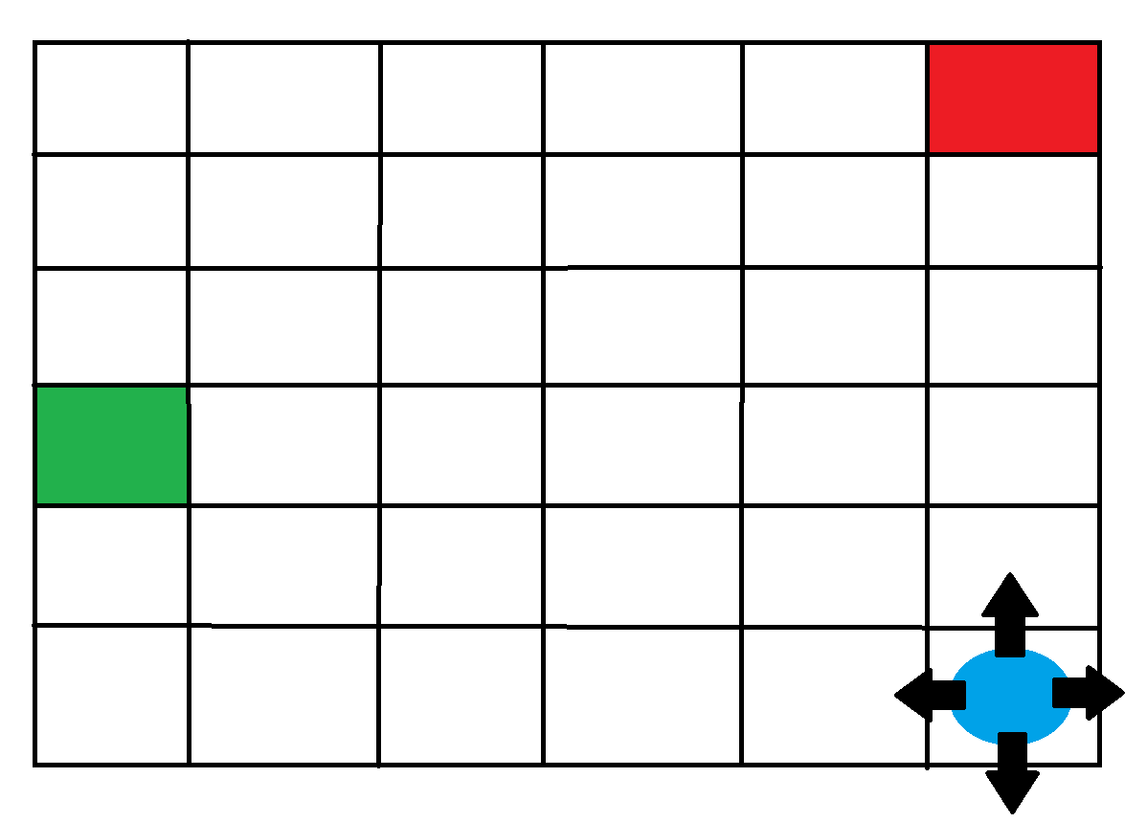


The Game
-1 point
GAME OVER
1 point
Victory!

Slide 5
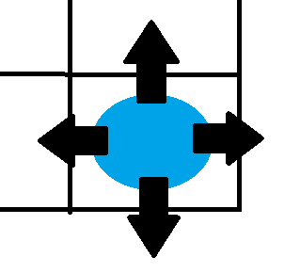









The Game
Up | Down | Left | Right
0 | 1 | 2 | 3
$$S_{t+2}$$
$$S_{t+1}$$
Up
Up
$$S_{t+2}$$
$$S_{t+1}$$
Down
Down
$$S_{t}$$
Left
$$S_{t+2}$$
Left
$$S_{t+1}$$
Right
Right
$$S_{t+2}$$
$$S_{t+1}$$

Slide 6
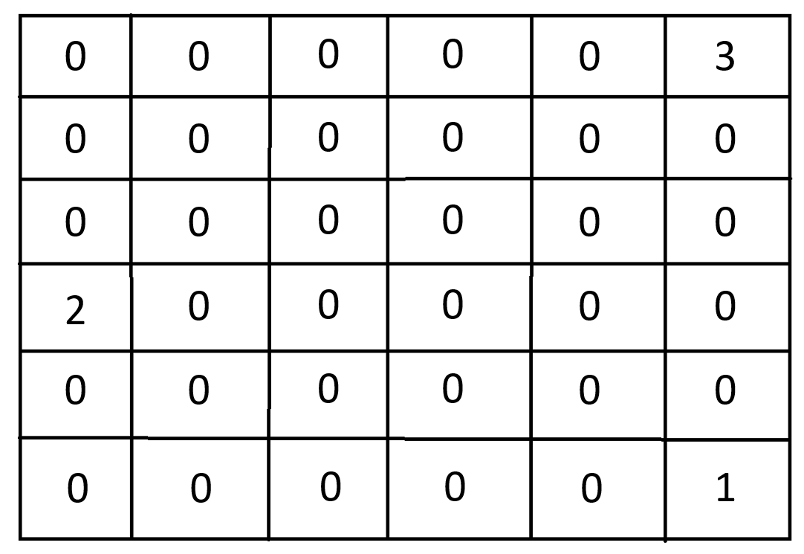
The Game

Slide 7




The Game
…

Slide 8

Coding!

